Slide 1

Decision Tree Basics
& Regression Trees
Team 1-9
By: Christine Malloy, Kaitlyn Neitz, Jacob Ranson, Bella Jin
Notes:
1
1

Slide 2



Agenda
Interpreting Measures Used for Regression Trees
Intro to Decision Tree Basics
Greedy Recursive Partitioning
Growing
(and pruning) decision trees in R
Lab: Boston Home Values

Slide 3
Classification And Regression Trees
The most widely deployed machine-learning based data mining model builder.
Pros of model:
Easy to view
Understand
Interpret
Cons of Model:
performance
Considered supervised learning method
Notes:
Since their development in the 1980s, classification and regression trees (also known as Decision Trees) have been the most widely deployed machine-learning based data mining model builder.
Their attraction lies in the simplicity of the resulting model, where a decision tree (at least one that is not too large) is quite easy to view, understand, and, importantly, to explain.
Decision trees do not always deliver the best performance, and so represent a trade-off between performance and simplicity of explanation.
These approaches are further examples of supervised learning methodologies (as were regression and classification)
AS LONG AS KEPT

Slide 4
Decision Tree Structure and Nomenclature
Root
Branches
Branches
Node
Node
Leaf
Leaf
Notes:
A decision tree starts with a single root node that splits into multiple branches, leading to further nodes, each of which may further split or else terminate as a leaf node.
Associated with each non-leaf node will be a test or question that determines which branch to follow.
The leaf nodes contain the "decisions" or "predictions."

Slide 5
Decision Tree Structure and Nomenclature
Question or Test
Root
Branches
Branches
Node
Node
Leaf
Leaf
Decision or Prediction
Notes:
A decision tree starts with a single root node that splits into multiple branches, leading to further nodes, each of which may further split or else terminate as a leaf node.
Associated with each non-leaf node will be a test or question that determines which branch to follow.
The leaf nodes contain the "decisions" or "predictions."

Slide 6
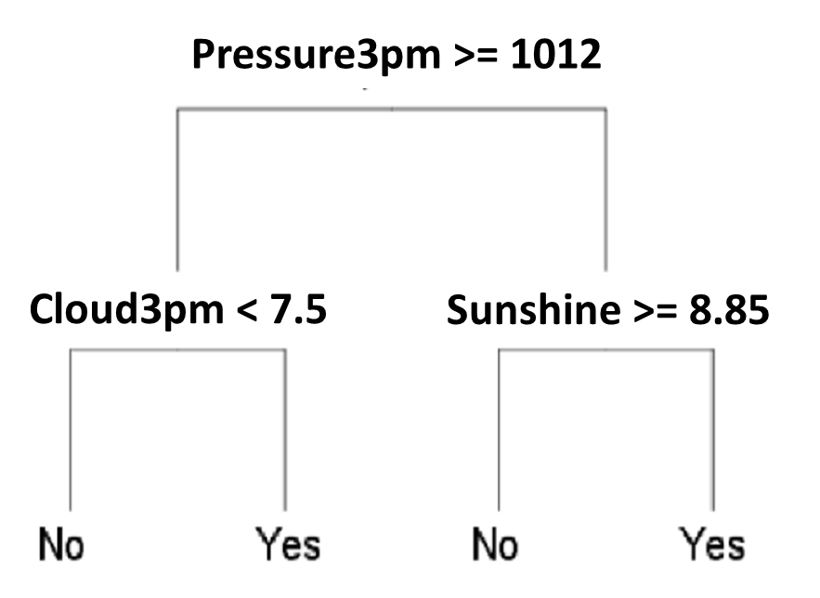
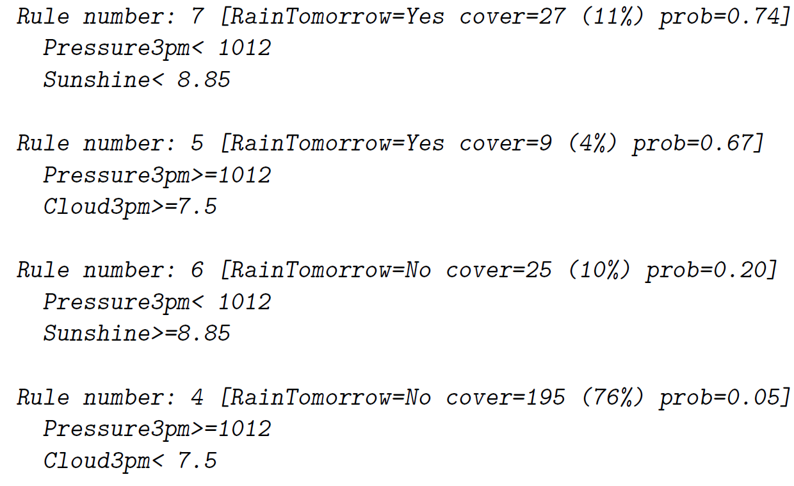
Making Rules From Trees
Condition
Met
Condition Not Met
True
False
True
False
Notes:
The decision tree at right translates to the following rule set, where each rule corresponds to one pathway through the decision tree, starting at the root node and terminating at a leaf node:
Since large trees are often simplified by cutting back (or pruning), we will often see rule numbers that are not sequential.

Slide 7
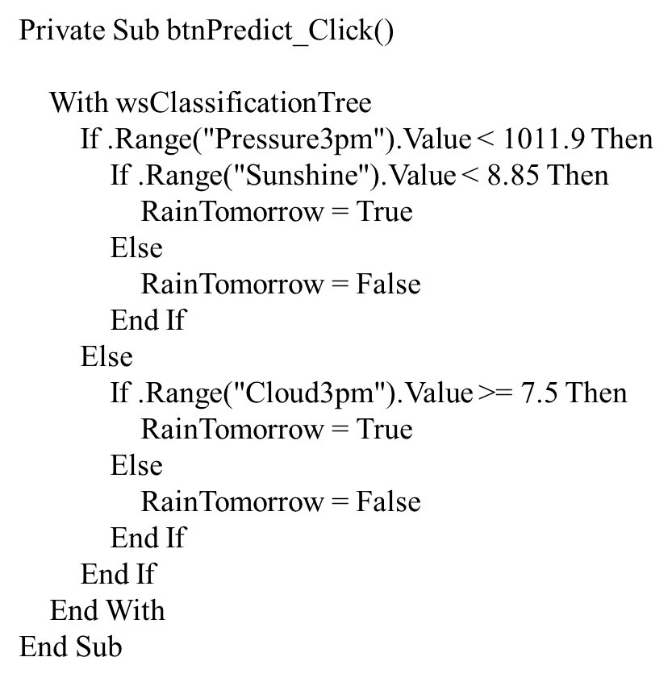
Making Rules From Trees
Notes:
Also, observe how readily a decision tree is converted to code:
Private Sub btnPredict_Click()
With wsClassificationTree
If .Range("Pressure3pm").Value < 1011.9 Then
If .Range("Sunshine").Value < 8.85 Then
RainTomorrow = True
Else
RainTomorrow = False
End If
Else
If .Range("Cloud3pm").Value >= 7.5 Then
RainTomorrow = True
Else
RainTomorrow = False
End If
End If
End With
End Sub

Slide 8
Probabilities
RainTomorrow=Yes
(prob=0.74)
What prediction occurred
Cover =27 (11%)
# of observation from training dataset
% of training dataset
Pressure3pm < 1012
Sunshine < 8.85
Conditions that need be met for information to be returned
Amount of observations covered by conditions
For 74% of the observations it rained the following day
Notes:
Probabilities are typically recorded for each leaf node of the decision tree to indicate the strength of the decision we derive from the model.
For example, consider rule 7:
For 74% of the observations (prob=0.74), it rained the following day (RainTomorrow=Yes) when
the pressure at 3 pm was less than 1012 hPa
the hours of sunshine were less than 8.85
The other information provided with the rule is that:
27 observations from the training dataset (i.e., 11% of the training dataset observations) are covered by this rule - they satisfy the two conditions.

Slide 9
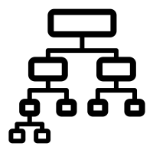
The Search Algorithm
Infinite collection of possible trees to choose from
Each variable can appear at any node
Branching can involve infinite testing
Can be computationally expensive
Finding a “good” model
Limiting the search space with training subset
Limit search time
Notes:
We generally have an infinite collection of possible trees to choose from
Each variable can appear at any node, and branching can involve testing many (sometimes infinite) values of a variable.
Enumerating every possible tree, and testing whether it is a good model, will generally be too computationally expensive.
Instead, we use the observations (or the training subset) to search the space of possible trees to find a "good" model in a reasonable amount of time.

Slide 10
Partitioning the Dataset
Top-down induction of decision trees
Uses a divide-and-conquer, or recursive partitioning, approach.
Consider the Weather dataset (myWeatherData.csv). The distribution of the observations, with respect to the target variable RainTomorrow, is of particular interest.
There are 66 observations that have the target as Yes (18%)
There are 300 observations that have the target as No (82%).
Notes:
The algorithm that has been developed for decision tree induction is referred to as the top-down induction of decision trees, using a divide-and-conquer, or recursive partitioning, approach.
Consider the Weather dataset (myWeatherData.csv). The distribution of the observations, with respect to the target variable RainTomorrow, is of particular interest.
There are 66 observations that have the target as Yes (18%)
There are 300 observations that have the target as No (82%).

Slide 11
Partitioning the Dataset
Split the dataset into two smaller datasets based on variable
Increase homogeneity of sets
Example – partitioning weather dataset
Use the variable Sunshine with a split of 9
Datasets will have 201 and 162 observations, respectively
Note that three observation have missing values
Notes:
We want to find an input variable that can split the dataset into two smaller datasets such that the homogeneity of each of the two datasets with respect to the target variable is increased.
That is, one of the datasets should have an increased proportion of observations with Yes while the other dataset should have an increased proportion of observations with No.
We might, for example, decide to construct a partition of the original dataset using the variable Sunshine with a split value of 9.
Every observation that has a value of Sunshine less than 9 goes into one subset and those remaining (with Sunshine greater than or equal to 9) into a second subset.
Datasets will have 201 and 162 observations, respectively
Note that three observations have missing values for this variable

Slide 12
Partitioning the Dataset
Splitting increased the homogeneity of the >= 9 dataset
There is clear favor of no rain event in >=9 dataset
Sunshine < 9
28% Yes
72% No
Sunshine >= 9
5% Yes
95% No
Original
18% Yes
82% No
Notes:
Now we consider the proportions of Yes and No observations within the two new datasets.
For the subset of observations with Sunshine < 9, the proportions are 28% Yes and 72% No.
For the subset of observations with Sunshine >= 9 the proportions are 5% Yes and 95% No.
By splitting on this variable, we have made an improvement in the homogeneity of the target variable values in the subset (Sunshine >= 9).
In particular, this split results in a collection of observations that are very much in favor of no rain on the following day (95% No), which is more homogenous than the original 18% / 82% split.
This is what we are aiming to do. It allows us to observe that when the amount of sunshine on any day is quite high (i.e., at least 9 hours), then there is very little chance of rain on the following day (only a 5% chance based on our observations from the particular weather station).

Slide 13
Partitioning the Dataset
A not so clear story with < 9 Sunshine
There is still an increased likelihood of rain the following day based on historic observations
Sunshine < 9
28% Yes
72% No
Sunshine >= 9
5% Yes
95% No
Original
18% Yes
82% No
Notes:
The story for the other dataset, where the new proportions are 28% Yes and 72% No, is not quite so clear.
The proportions have certainly changed from the original 18% Yes and 82% No, with a higher proportion of Yes observations than the original dataset, but the No observations still outnumber the Yes observations.
Nonetheless, we can say that when we observe Sunshine < 9 there is an increased likelihood of rain the following day based on our historic observations.
There is a 28% chance of rain compared with an 18% over all observations.

Slide 14
Partitioning the Dataset
Weather
Data
Sunshine < 5
Sunshine >= 5
Sunshine
Split of 5
Yes: 41%
No: 59%
Yes: 12%
No: 88%
Cloud3pm
Split of 6
Pressure3pm
Split of 1012
Cloud3pm < 6
Cloud3pm >= 6
Pressure3pm < 1012
Pressure3pm >= 1012
Yes: 8%
No: 92%
Yes: 34%
No: 66%
Yes: 47%
No: 53%
Yes: 10%
No: 90%
Notes:
Choosing the value 9 for the variable Sunshine is just one possibility from amongst very many choices.
If we had chosen the value 5 for the variable Sunshine we would have two new datasets with the Yes/No proportions 41%/59% and 12%/88%.
Choosing a different variable altogether (say Cloud3pm) with a split of 6, we would have two new datasets with the Yes/No proportions 8%/92% and 34%/66%.
Another choice might be Pressure3pm with a split of 1012, having Yes/No proportions of 47%/53% and 10%/90%.

Slide 15
Partitioning the Dataset
Which of these datasets is the best split
Clearly, we need a measure of "goodness“
We come back to this question shortly, but for now, we assume we choose one of them.
The end result is having two new smaller datasets
Say we chose the split based on Sunshine at 9…
Notes:
We now have a collection of choices for how we might partition our training dataset: which of these is the best split?
Clearly, we need a measure of "goodness". We come back to this question shortly, but for now, we assume we choose one of them.
With whichever choice we make, the result is that we now have two new smaller datasets.
Say we chose the split based on Sunshine at 9…

Slide 16
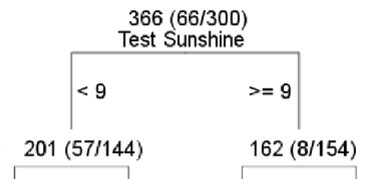
Recursive Partitioning
The process is repeated again separately for the two new datasets
Review all possible variables and split into two smaller datasets as well
Notes:
The process is now repeated again separately for the two new datasets.
That is, for the left dataset above (observations having Sunshine < 9), we consider all possible variables and splits to partition that dataset into two smaller datasets.
Independently, for the right dataset (observations having Sunshine >= 9) we consider all possible variables and splits to partition that dataset into two smaller datasets as well.

Slide 17
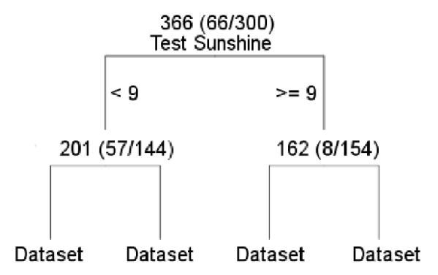
Recursive Partitioning
The process continues as you choose the “best” variable and split per stage
If we are allowed to go until the end, the process stops when:
All samples for a given node belong to the same class
Partitioning the dataset no longer improves the proportions/outcome
Notes:
Now we have four even smaller Datasets, and the process continues.
For each of the four datasets, we again consider all possible variables and splits, choosing the "best" at each stage, and repeating the process until we decide that we should stop.
In general, we might stop when
All samples for a given node belong to the same class
When further partitioning the dataset does not improve the proportions or the outcome.
IF WE SPLIT UNTIL THE END VS USING THE PARAMETERS TO STOP

Slide 18
Recursive Partitioning
This process is called divide-and-conquer or recursive partitioning.
At each step:
divide the dataset into two smaller datasets
conquer the "disorder" by finding a way to divide each into more "orderly" datasets.
Each step is done independently, to each of the smaller datasets repeatedly
thus it is recursive partitioning
Notes:
This process is called divide-and-conquer or recursive partitioning.
At each step, we divide the dataset into two smaller datasets and conquer the "disorder" by finding a way to divide each into more "orderly" datasets.
We are also repeatedly partitioning the dataset and applying the same process, independently, to each of the smaller datasets; thus it is recursive partitioning.

Slide 19
A Greedy Recursive Partitioning Algorithm
At each stage of the process, we make a decision as to the best variable and split to partition the data, and once we make that decision, we stay with it for the rest of the tree.
We want to split the region that minimizes RSS
Though our solution may be sub-optimal
Reduces the computational complexity of search heuristics
Efficiency comes at the expense of optimality – we sacrifice our opportunity to find the best decision tree
Notes:
At each stage of the process, we make a decision as to the best variable and split to partition the data, and once we make that decision, we stay with it for the rest of the tree.
The decision may not be the best to make in the overall context of building this decision tree.
Perhaps a suboptimal step now would set up a much better situation later, for example, but the "greediness" prevents this.
Greedy algorithms are a common way reduce the computational complexity of search heuristics such as this. Efficiency comes, however, at the expense of optimality – we sacrifice our opportunity to find the very best decision tree.

Slide 20
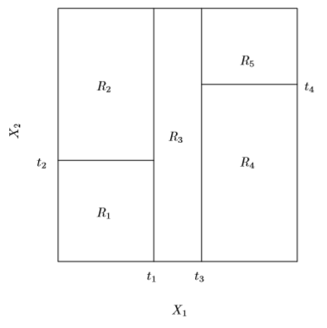
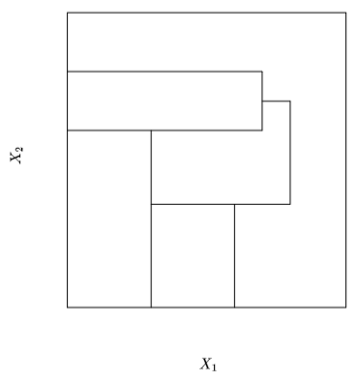
A Greedy Recursive Partitioning Algorithm
Recursive Binary Splitting
Partition of two-dimensional feature space

Slide 21
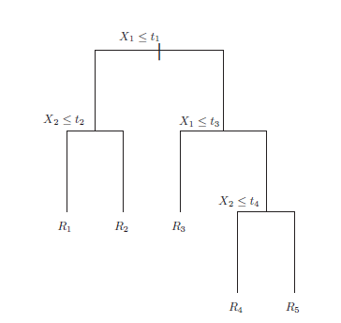
A Greedy Recursive Partitioning Algorithm
Recursive Binary Splitting
R₅
R₂
t₄
X₂
R₃
t₂
R₄
R₁
t₁
t₃
X₁

Slide 22

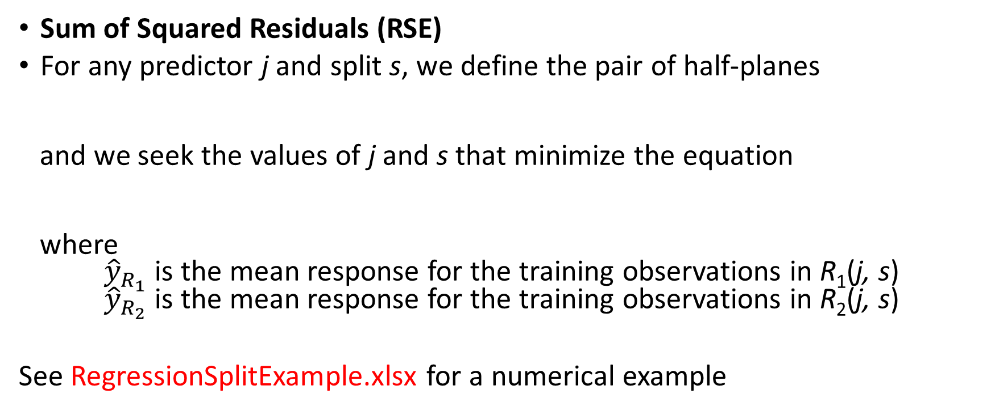
Measures of Goodness - Regression Trees
Sum of Squared Residuals (RSE)
For any predictor j and split s, we define the pair of half-planes
and we seek the values of j and s that minimize the equation
where ${\hat{y}}_{R_{1}}$ is the mean response for the training observations in R₁(j, s) ${\hat{y}}_{R_{2}}$ is the mean response for the training observations in R₂(j, s)
See RegressionSplitExample.xlsx for a numerical example
Notes:
In describing the basic algorithm above (a classification tree example since the dependent variable was categoric), it was indicated that we need to measure how good a particular partition of the dataset is.
Such a measure will allow us to choose from amongst a collection of possibilities. We now consider how to measure the different splits of the dataset.
The measures used for regression trees and classification trees differ…
For regression trees, the measure of the goodness of a split is the familiar sum of the squared residuals (RSE).
For any predictor j and split s, we define the pair of half-planes and we seek the values of j and s that minimize the equation
where ${\hat{y}}_{R_{1}}$ is the mean response for the training observations in R₁(j, s) ${\hat{y}}_{R_{2}}$ is the mean response for the training observations in R₂(j, s).
See RegressionSplitExample.xlsx for a numerical example

Slide 23
What measure are we trying to minimize?
Adjusted R-squared
Residual Sum of Squares
Mean Squared Error
BIC

Slide 24
Recursive partitioning is a _____ approach?
Top-Down Greedy
Fantastic
Slow
Top-Up Greedy

Slide 25
It is computationally _____ to consider every possible partition of the feature space.
Feasible
Recommended
Infeasible
Worth while

Slide 26
Tuning Parameters
The rpart() function has two arguments for tuning the algorithm, each being a structure containing other options.
control= and parms=
method = argument
indicates the type of model to be built and is dependent on the target variable.
method = “class”
Used for categorical targets when we build classification models
method = “anova”
Used for numeric target variables when we build regression models
"ANalysis Of VAriance"
Notes:
The rpart() function has two arguments for tuning the algorithm, each being a structure containing other options.
control= and parms=
Consider the following example:
The method= argument indicates the type of model to be built and is dependent on the target variable.
For categoric targets, we build classification models, and so we use method="class".
For numeric target variables, we build regression models, and so we use method="anova" for "ANalysis Of VAriance"

Slide 27
Tuning Parameters
minsplit= argument
Specifies the minimum number of observations in a node
The default value of minsplit= is 20.
Changing the value of minsplit= allows us to eliminate some computation
Nodes with a small number of observations will generally play less of a role in our models, and are often pruned away.
Notes:
anothermodel<-rpart(RainTomorrow ~ .,data=weather[train,], method="class", parms=list(split="information"), control=rpart.control(minsplit=20, cp=.01,minbucket=7,maxdepth=20,usesurrogate=0,maxsurrogate=0))
The split= argument is used to choose between different splitting functions (measures).
The argument appears within the parms argument of rpart(), which is built up as a named list.
The split="information" directs rpart to use the information gain measure we introduced earlier.
The default choice of split="gini" uses the Gini index of diversity, also mentioned earlier.
anothermodel<-rpart(RainTomorrow ~ .,data=weather[train,], method="class", parms=list(split="information"), control=rpart.control(minsplit=20, cp=.01,minbucket=7,maxdepth=20,usesurrogate=0,maxsurrogate=0))
The minsplit= argument species the minimum number of observations in a node for which rpart will even try to compute a split.
The default value of minsplit= is 20.
Changing the value of minsplit= allows us to eliminate some computation, as nodes with a small number of observations will generally play less of a role in our models, and are often pruned away (more about pruning shortly).

Slide 28
Tuning Parameters
minbucket= argument
Can construct Leaf nodes with fewer observations than minsplit =
Sets the minimum number of observations in any leaf node
Default value for minbucket is 7
The smaller the minsplit value, the larger the decision tree
maxdepth = argument
Sets the maximum depth of any node of the final tree, with the root node counted as depth 0
maxcompete = argument
Limits the number of competing alternative (but rejected) splits retained in the output.
Useful to know not just which split was chosen, but which variable came in second, third, etc.
Notes:
anothermodel<-rpart(RainTomorrow ~ .,data=weather[train,], method="class", parms=list(split="information"), control=rpart.control(minsplit=20, cp=.01,minbucket=7,maxdepth=20,usesurrogate=0,maxsurrogate=0))
Leaf nodes, however, can still be constructed that have fewer observations than the minsplit=, as that is controlled by the minbucket= argument, which sets the minimum number of observations in any leaf node.
The default value for minbucket is 7, or about one-third of the default value of minsplit, which is 20.
Generally, the smaller the minsplit value, the larger the decision tree, since we are allowing leaf nodes with a smaller number of observations to be considered, and hence the option to split a node into smaller nodes will often be exercised by the tree building algorithm.
If either of these two arguments is specified but not the other, then the default of the unspecified one is taken to be a value such that this relationship holds, i.e., minbucket is approximately one-third of minsplit
maxdepth= sets the maximum depth of any node of the final tree, with the root node counted as depth 0
maxcompete= limits the number of competing alternative (but rejected) splits retained in the output.
It is useful to know not just which split was chosen, but which variable came in second, third, etc. .

Slide 29
Minsplit
minsplit = 14
12 Observations
Notes:
The grey leaf nodes shown have not yet been split.
What we are trying to understand here is how minsplit works.
We have set minsplit to 14.
Because the blue leaf node only has 12 observations we are NOT able to split that node any further and the tree stops there.

Slide 30
Minbucket
minsplit = 14
14 Observations
minbucket = 7
5 Observations
9 Observations
Notes:
The grey leaf nodes shown have not yet been split.
What we are trying to understand here is how minsplit and minbucket works.
We have set minsplit to 14.
BUT…
We have also set minbucket to 7.
This means that each new leaf MUST include at least 7 observations.
Because of the way the data would be split up the LEFT leaf node only has 5 observations, therefore we can NOT make this split either even though the minsplit is 14.

Slide 31
The Complexity Parameter (CP)
The complexity parameter controls the process of pruning a decision tree
cp = argument
Governs the minimum "benefit" that must be gained at each split of the decision tree in order to make a split worthwhile
Saves on computing time by eliminating splits that add little value to the model.
The default is cp=0.01.
Notes:
anothermodel<-rpart(RainTomorrow ~ .,data=weather[train,], method="class", parms=list(split="information"), control=rpart.control(minsplit=20, cp=.01,minbucket=7,maxdepth=20,usesurrogate=0,maxsurrogate=0))
The complexity parameter controls the process of pruning a decision tree. Without pruning, a decision tree model can over-train the training data and then not perform very well on new data.
In general, the more complex a model, the more likely it is to match the data on which it has been trained and the less likely it is to match new, previously unseen data.
On the other hand, decision tree models are very interpretable, and thus building a more complex tree (i.e., having many branches) is sometimes tempting (and useful). It can provide insights that we can then test statistically.

Slide 32
The Complexity Parameter (CP)
To build a maximal tree, use:
cp=?, minbucket=?, and minsplit=?
Useful if we want to look at the values for CP for various tree sizes.
We look for the number of splits where the x-error (cross-validation error relative to the root node error) is minimum (or sometimes the sum of xerror and xstd (the standard deviation of xerror)). This is usually early in the list.
Notes:
anothermodel<-rpart(RainTomorrow ~ .,data=weather[train,], method="class", parms=list(split="information"), control=rpart.control(minsplit=20, cp=.01,minbucket=7,maxdepth=20,usesurrogate=0,maxsurrogate=0))
Using cp= governs the minimum "benefit" that must be gained at each split of the decision tree in order to make a split worthwhile.
This therefore saves on computing time by eliminating splits that appear to add little value to the model.
The default is cp=0.01. A value of 0 will build a "complete" decision tree to maximum depth depending on the values of minsplit= and minbucket=.
To build a maximal tree, therefore, use cp=0, minbucket=1, and minsplit=2
This is useful if we want to look at the values for CP for various tree sizes. We look for the number of splits where the xerror (cross-validation error relative to the root node error) is minimum (or sometimes the sum of xerror and xstd (the standard deviation of xerror)). This is usually early in the list.

Slide 33
The Complexity Parameter (CP)
To build a maximal tree, use:
cp=0, minbucket=1, and minsplit=2
Useful if we want to look at the values for CP for various tree sizes.
We look for the number of splits where the x-error (cross-validation error relative to the root node error) is minimum (or sometimes the sum of xerror and xstd (the standard deviation of xerror)). This is usually early in the list.
Notes:
anothermodel<-rpart(RainTomorrow ~ .,data=weather[train,], method="class", parms=list(split="information"), control=rpart.control(minsplit=20, cp=.01,minbucket=7,maxdepth=20,usesurrogate=0,maxsurrogate=0))
Using cp= governs the minimum "benefit" that must be gained at each split of the decision tree in order to make a split worthwhile.
This therefore saves on computing time by eliminating splits that appear to add little value to the model.
The default is cp=0.01. A value of 0 will build a "complete" decision tree to maximum depth depending on the values of minsplit= and minbucket=.
To build a maximal tree, therefore, use cp=0, minbucket=1, and minsplit=2
This is useful if we want to look at the values for CP for various tree sizes. We look for the number of splits where the xerror (cross-validation error relative to the root node error) is minimum (or sometimes the sum of xerror and xstd (the standard deviation of xerror)). This is usually early in the list.

Slide 34
The Complexity Parameter (CP)
printcp()
print(model$cp)
The plotcp() command is useful in visualizing the progression of the CP values.
In the following example, we build a full decision tree with both
cp=0, minbucket=1 and minsplit=2.
We also show the CP table and the corresponding plot.
Notes:
We saw the printcp() and print(model$cp) functions earlier.
The plotcp() command is useful in visualizing the progression of the CP values. In the following example, we build a full decision tree with both cp=0, minbucket=1 and minsplit=2. We also show the CP table and the corresponding plot.
mymodel<-rpart(RainTomorrow~.,data=weather[train,],method="class",
parms=list(split="information"),control=rpart.control(usesurrogate=0,
maxsurrogate=0,cp=0,minbucket=1,minsplit=2))
print(mymodel$cptable)

Slide 35
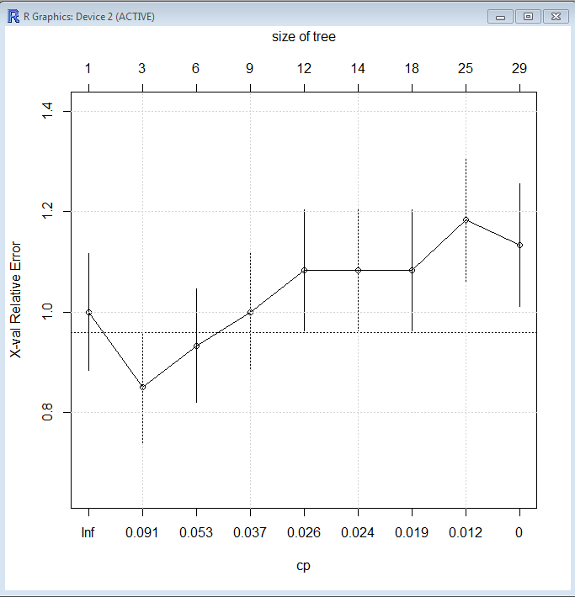
The Complexity Parameter (CP)
As we build a more flexible model (the x-axis), the c.v. error rate (the y-axis) initially decreases, then begins to increase
We will want to choose a model where it has assumed its minimum c.v. error rate
Dashed line is one standard deviation; choose the closest point under the line
Notes:
plotcp(mymodel)
grid()
The figure illustrates a typical behavior of model building. As we proceed to build a ever more flexible model (the x-axis), the c.v. error rate (the y-axis) initially decreases, then begins to increase.
We will want to choose a model where it has assumed its minimum c.v. error rate (here, at cp=.056 (from table on previous slide).

Slide 36
Using the CP to Prune a Tree
Cost Complexity Pruning (weakest link pruning)
Rather than considering every possible subtree, we consider a sequence of trees
As a script, we could automate the selection of the min xerror and associated CP, then perform the pruning of the tree as follows:
###Pruning the maximal tree to minimize xerror
mymodel$cptable
xerr<-mymodel$cptable[,"xerror"]
minxerr<-which.min(xerr)
mincp<-mymodel$cptable[minxerr,"CP"]
mymodel.prune<-prune(rmymodel,cp=mincp)
mymodel.prune$cptable
fancyRpartPlot(mymodel.prune, main="Pruned Decision Tree weather.csv $ RainTomorrow")
asRules(mymodel.prune)
Notes:
As a script, we could automate the selection of the min xerror and associated CP, then perform the pruning of the tree as follows:
###Pruning the maximal tree to minimize xerror
mymodel$cptable
xerr<-mymodel$cptable[,"xerror"]
minxerr<-which.min(xerr)
mincp<-mymodel$cptable[minxerr,"CP"]
mymodel.prune<-prune(rmymodel,cp=mincp)
mymodel.prune$cptable
fancyRpartPlot(mymodel.prune, main="Pruned Decision Tree weather.csv $ RainTomorrow")
asRules(mymodel.prune)

Slide 37
Making Predictions with the Model
We can now use the model to predict the outcome for new observations (prediction is often called "scoring”)
As with earlier models, we use the predict() function to make predictions
Notes:
Make our own version
We can now use the model to predict the outcome for new observations (prediction is often called "scoring.)"
As with earlier models, we use the predict() function to make predictions and the table() function to display the confusion matrix (a.k.a. Contingency Table) resulting from the predictions.
Here, we also display the table() function output as percentages.
mymodel.prune.predict <- predict(mymodel.prune, newdata=weather.test, type="class")
table(weather.test$RainTomorrow, mymodel.prune.predict,dnn=c("Actual", "Predicted"))
round(100*table(weather.test$RainTomorrow, mymodel.prune.predict,dnn=c("% Actual", "% Predicted"))/length(mymodel.prune.predict))

Slide 38
Example Code in R

Slide 39
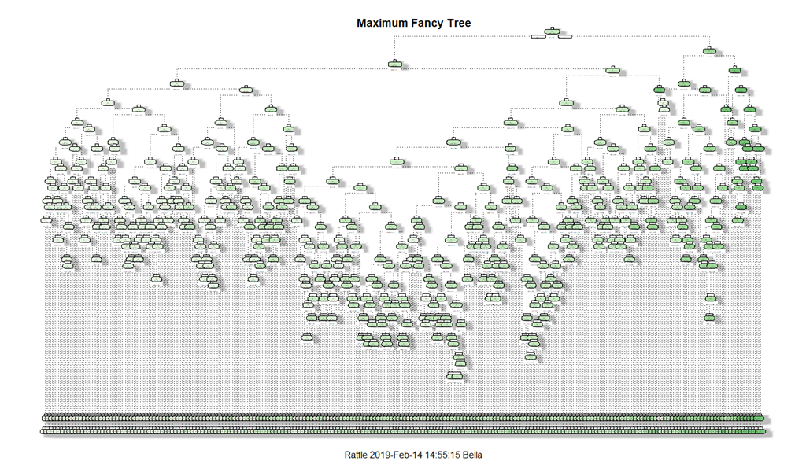
Maximal Spanning Tree

Slide 40
In-Class Lab

